Slide 1

Introduction to Software Architecture
Building complex software systems without a clear blueprint is like constructing a skyscraper without architectural plans. Software architecture provides the essential framework that transforms ideas into robust, scalable systems.

Slide 2

What is Software Architecture?
Software architecture is the high-level structure of a software system—the fundamental organization that shapes everything that follows. It's the master plan that defines how your system will grow, adapt, and succeed over time.
Major Components
Interactions
The building blocks of your system—services, modules, databases, and APIs that form the foundation
How components communicate, share data, and coordinate to deliver functionality
Technology Choices
Quality Attributes
Decisions about frameworks, languages, platforms, and constraints that shape implementation
How the system meets non-functional requirements like performance, security, and scalability

Slide 3
Why Software Architecture is Important
The difference between successful systems and failed projects often comes down to architectural decisions made early in development. Good architecture isn't optional—it's fundamental to long-term success.

Slide 4
The Complexity Challenge
Without proper architecture, development teams face mounting technical debt, integration nightmares, and systems that become impossible to maintain or scale. Software architecture provides the high-level blueprint that guides how systems are organized and how all parts interact cohesively.
80%
Projects Exceed Budget
Knight Capital Group, a major U.S. trading firm, lost $440 million in just 45 minutes due to a software architecture failure.During an upgrade, legacy code (“Power Peg”) that shouldn’t have been active was accidentally left running on one of its trading servers.That bug caused their algorithm to fire off millions of erroneous trades at inflated prices, wreaking havoc in the stock market. The crash wiped out much of Knight’s capital and forced the firm to raise emergency funding.In the end, the incident highlighted how fragile high-frequency trading systems can be without robust testing and deployment processes.
Due to poor architectural decisions
3x
Development Time
Lost fixing architectural issues

Slide 5

Six Critical Benefits of Good Architecture
01
02
Reduces Complexity
Improves Maintainability
Breaks large, overwhelming systems into manageable, understandable parts that teams can work on independently
Clear structure makes debugging faster, updates easier, and onboarding new developers smoother
03
04
Ensures Scalability
Aligns Teams
Supports growing numbers of users, increasing data volumes, and expanding traffic without system rewrites
Provides shared understanding across developers, designers, testers, and business stakeholders
05
06
Enhances Reliability & Security
Enables Evolution
Architectural decisions proactively avoid bottlenecks, vulnerabilities, and single points of failure
New features can be added, technologies can be upgraded, and business needs can be met without breaking existing functionality
Bottom line: Good architecture equals lower costs, fewer failures, better performance, and happier teams.

Slide 6
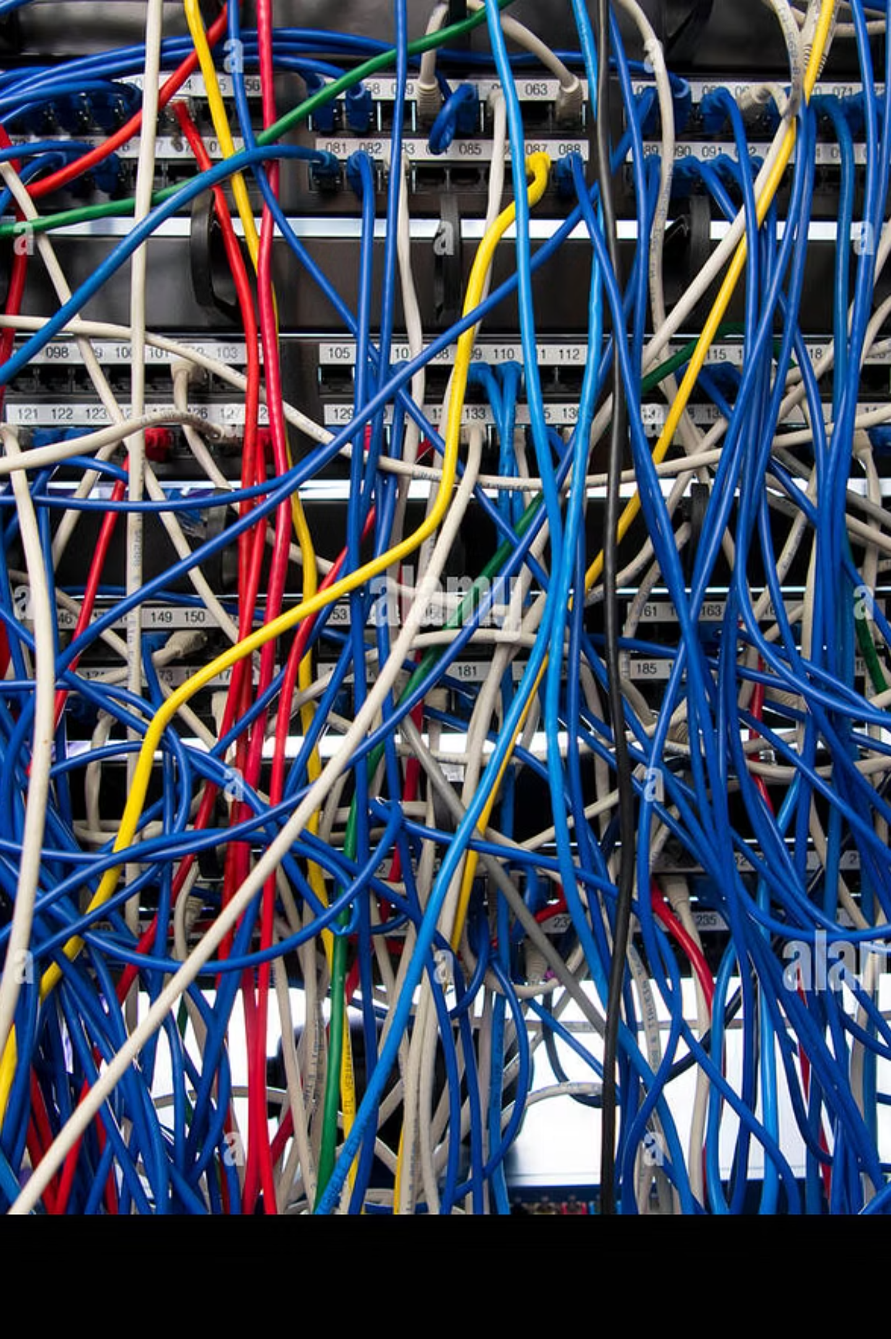
The Cost of Poor Architecture
Technical Debt Accumulation
Quick fixes and shortcuts compound over time, making every change progressively more difficult and risky
Performance Bottlenecks
Systems slow to a crawl under load because fundamental structural issues can't be patched away
Security Vulnerabilities
Architectural flaws create attack surfaces that no amount of code-level security can fully address
Development Paralysis
Teams fear making changes because the system is so fragile that any modification might break everything

Slide 7
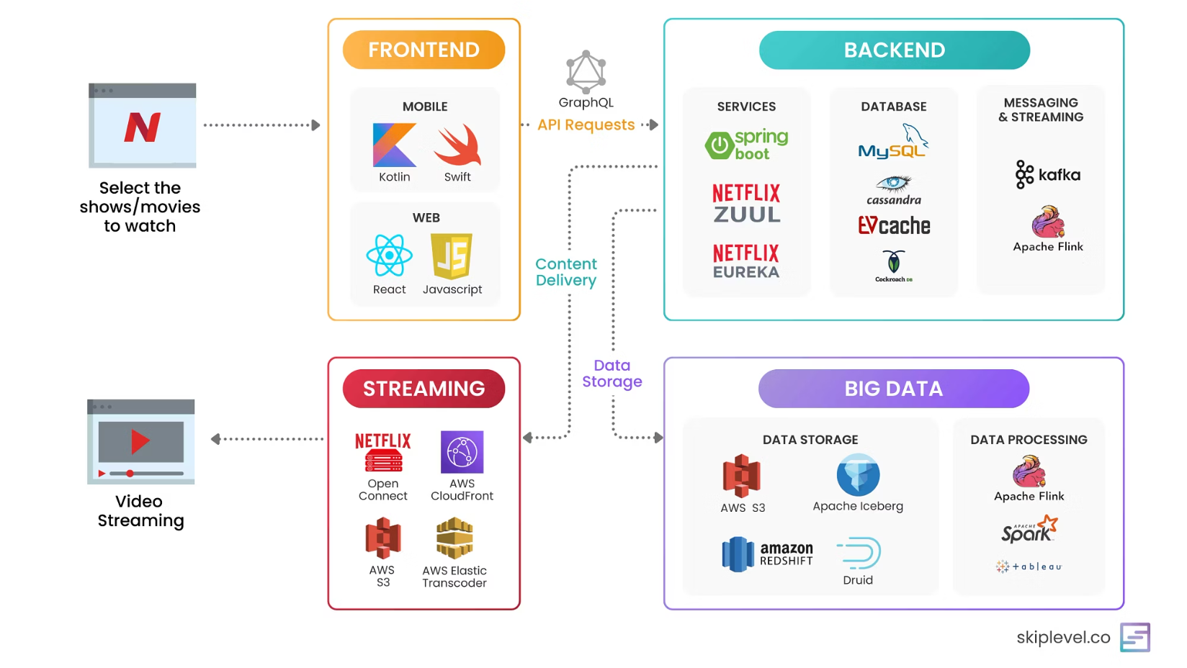
Real-World Example: Netflix Architecture
Netflix's architecture demonstrates software architecture in action. Their system handles over 200 million subscribers streaming billions of hours of content monthly.
Key architectural decisions:
Microservices architecture with 700+ independent services
Cloud-based infrastructure on AWS for global scalability
Content delivery network (CDN) for performance
Chaos engineering to ensure reliability
Event-driven communication between services
These architectural choices enable Netflix to scale globally, deploy updates hundreds of times daily, and maintain 99.99% uptime.

Slide 8
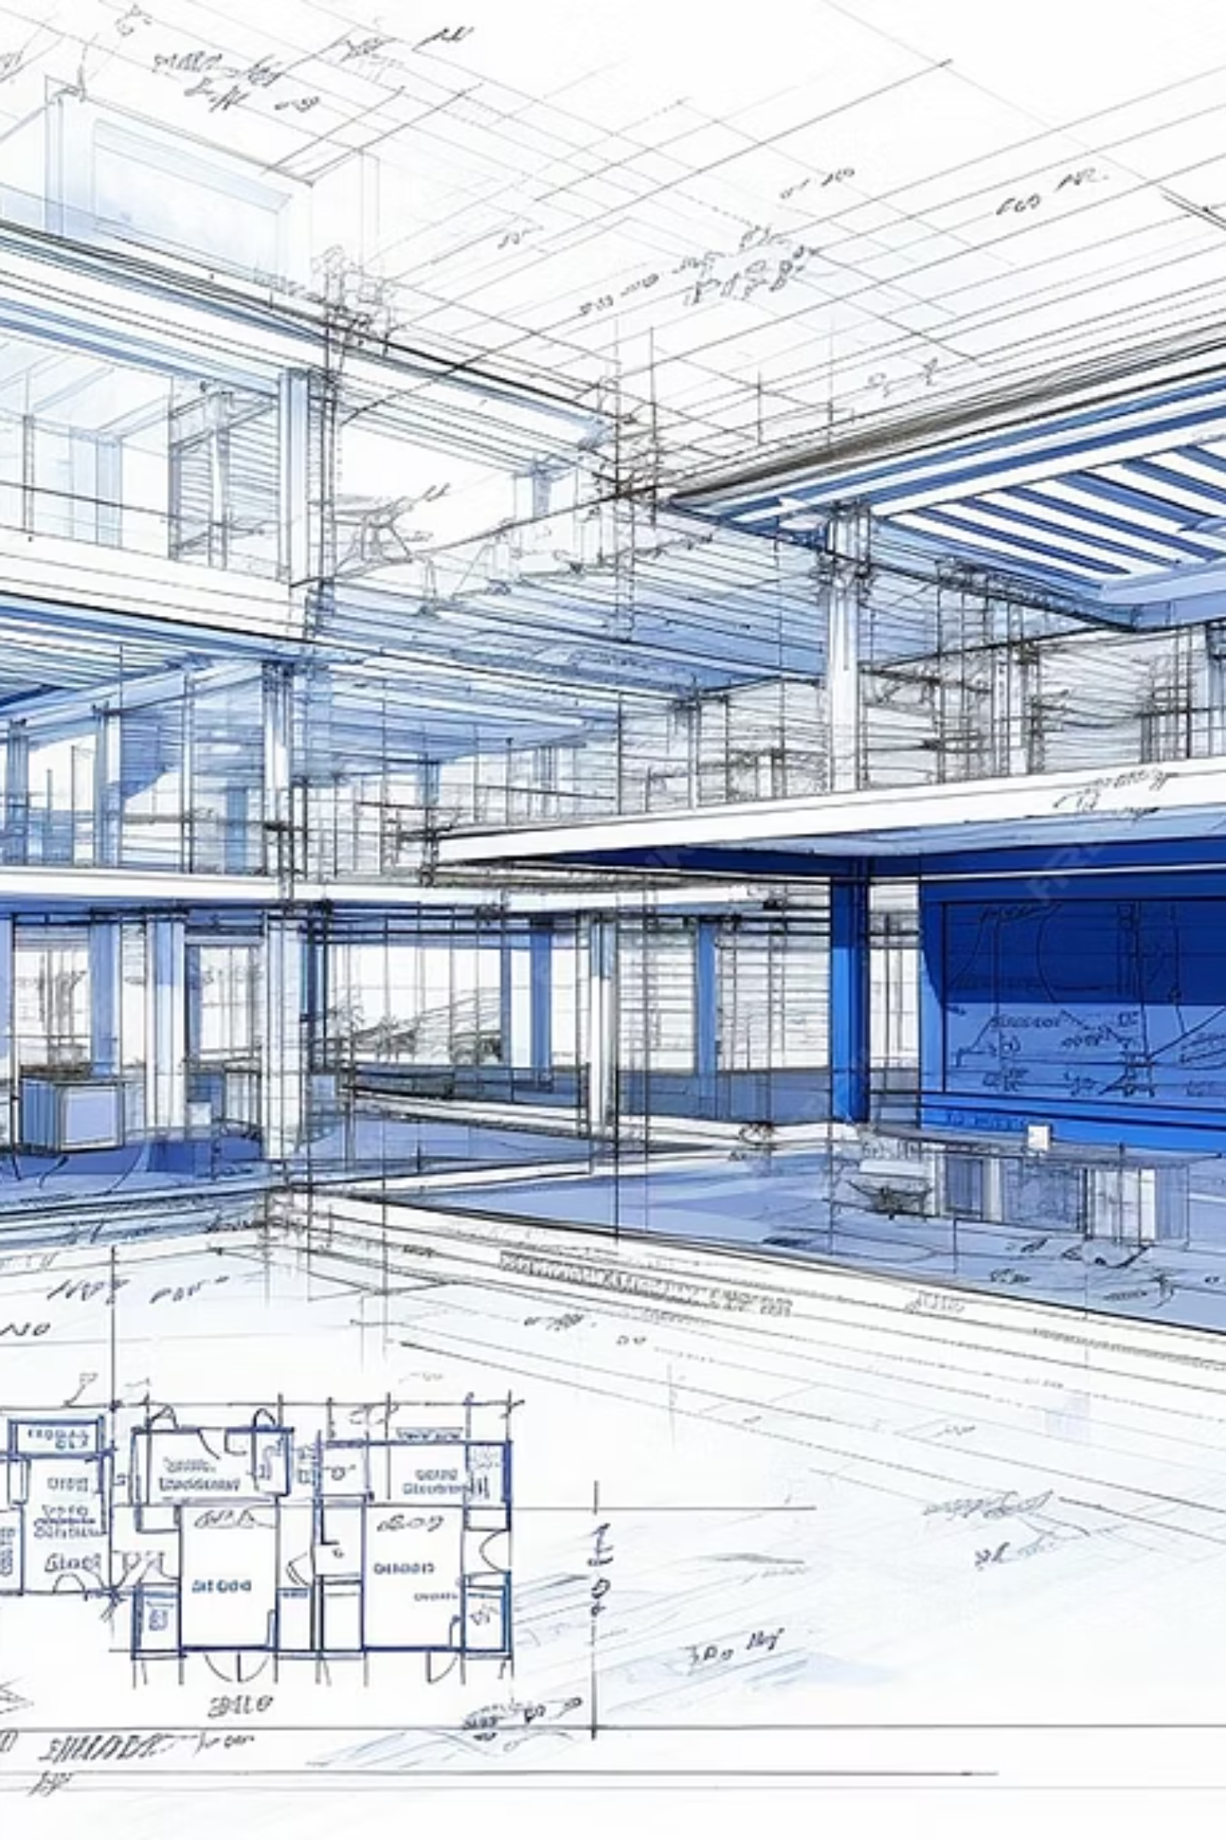
Architecture vs. Design: Understanding the Distinction
While architecture and design are related, they operate at different levels of abstraction and have distinct purposes. Understanding this difference is crucial for effective software development.
Software Architecture
High-level structure of the entire system
Focuses on components, modules, and their interactions
Addresses non-functional requirements (scalability, performance, security)
Long-term and relatively stable
Decisions are difficult and expensive to reverse
Example: "Use microservices architecture with API gateway and event bus"
Software Design
Low-level implementation details within components
Focuses on classes, functions, algorithms, and data structures
Addresses functional requirements (what the system does)
Can change frequently during development
Decisions can be modified with relative ease
Example: "UserService class calls authenticate() method from AuthModule"

Slide 9
Real-World Comparison: E-Commerce Platform
Architectural Level
Design Level
Decisions that shape the entire system:
Implementation details within services:
Deploy as microservices on Kubernetes
Create ProductRepository class with CRUD methods
Use PostgreSQL for transactional data, MongoDB for product catalog
Implement factory pattern for payment processors
Use strategy pattern for shipping calculations
Implement CQRS pattern for order processing
Write unit tests with 80% coverage target
Cache frequently accessed data with Redis
Apply observer pattern for inventory updates
Use message queues for asynchronous processing
Structure folders by feature modules
Deploy across multiple regions for disaster recovery
These decisions affect specific modules and can evolve as needed.
These decisions affect the entire team and are expensive to change.

Slide 10
Quick Check: Architecture vs. Design
Let's see how well we've understood the distinction!
Deciding the whole app will have a “Frontend,” “Backend,” and “Database.”
Creating a class called LoginForm with fields for username and password.
Choosing to build the system using Cloud services (AWS/Azure).
Writing the logic for how a button works when clicked.
Choosing a database type: SQL or NoSQL.

Slide 11
Architectural Views
Complex systems cannot be fully captured in a single diagram. Different stakeholders need different perspectives to understand and work with the architecture effectively.

Slide 12
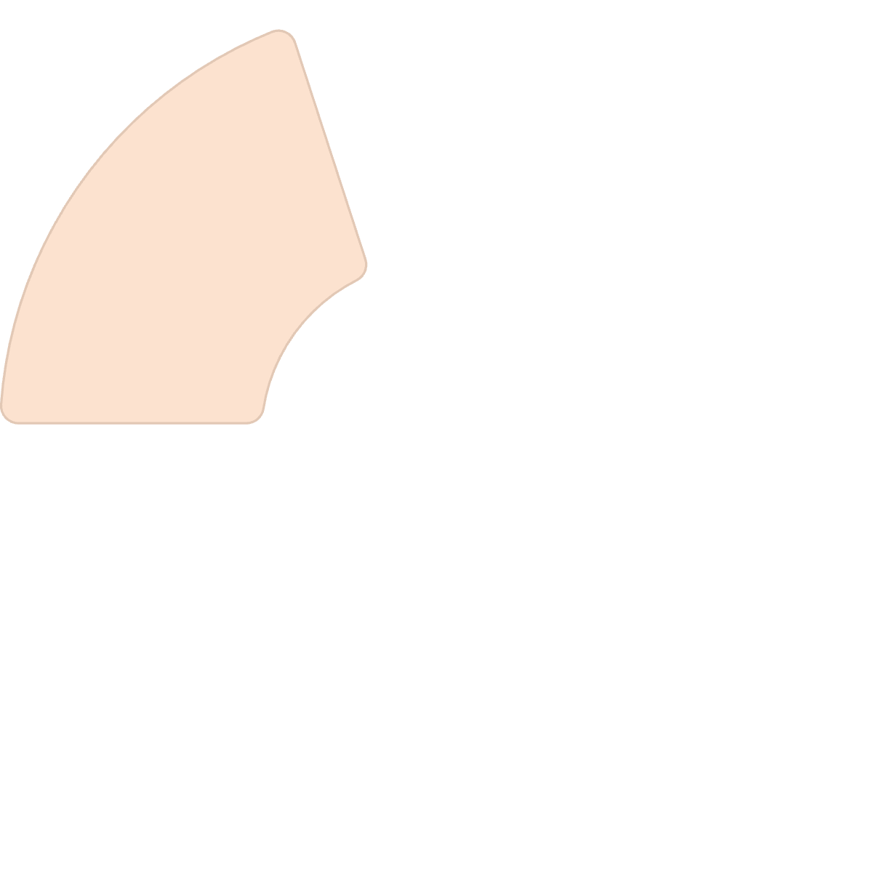
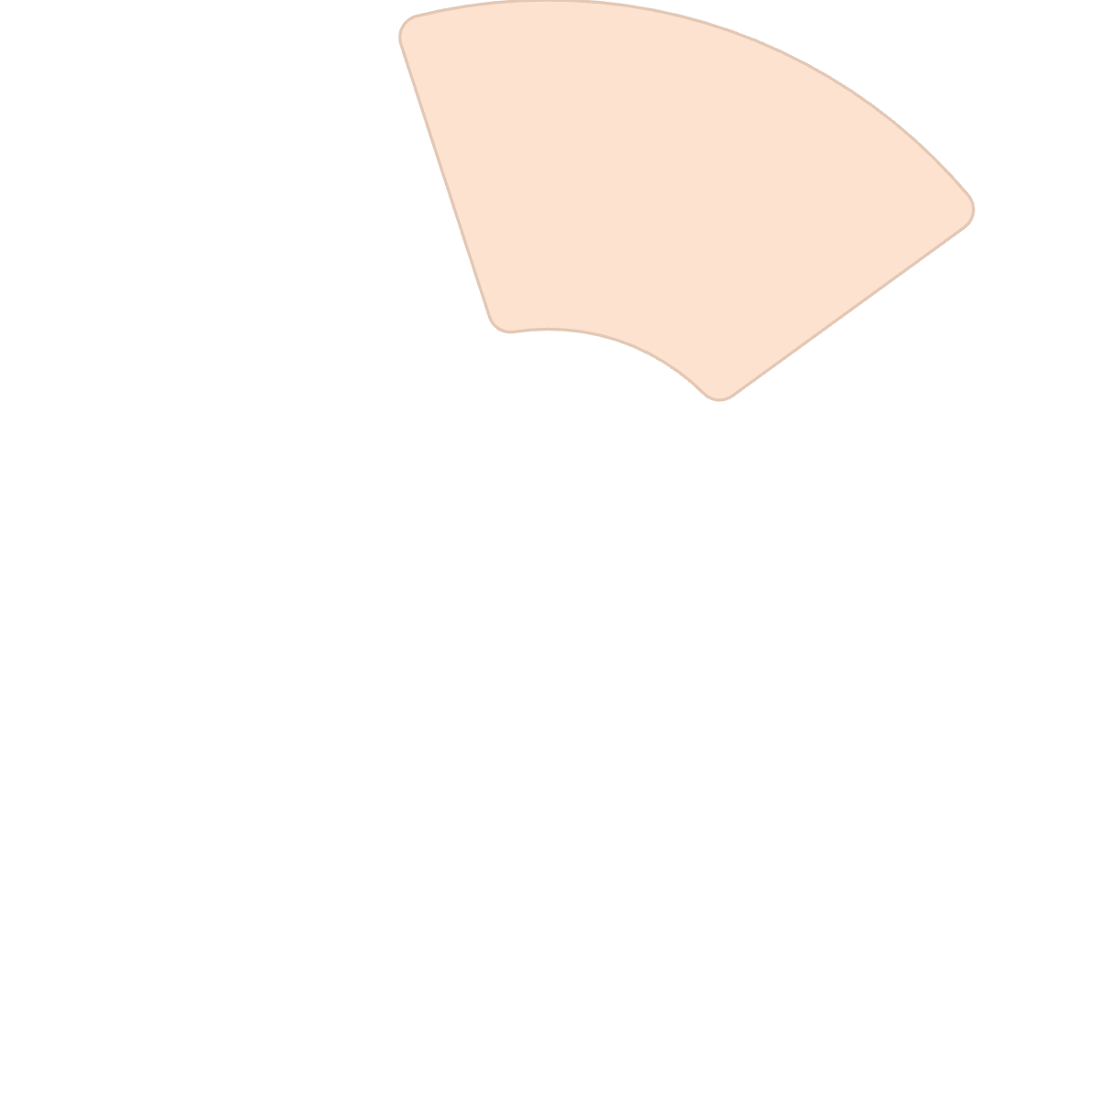
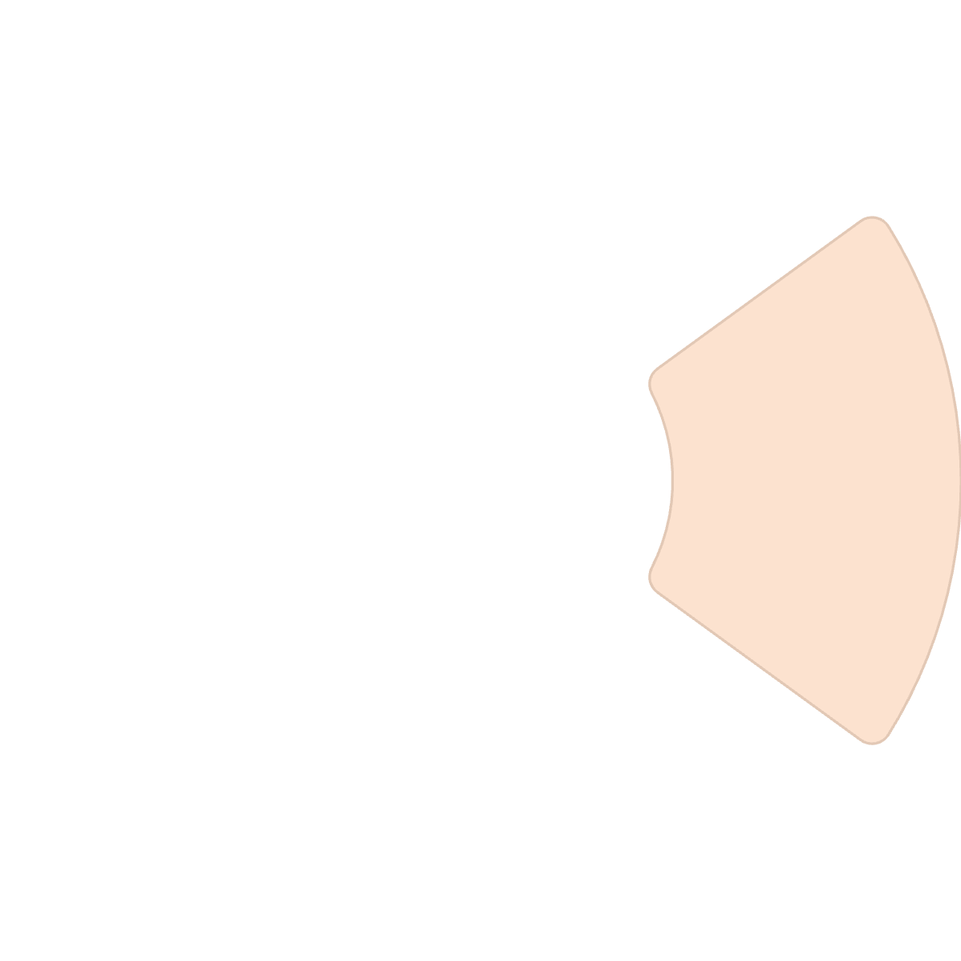
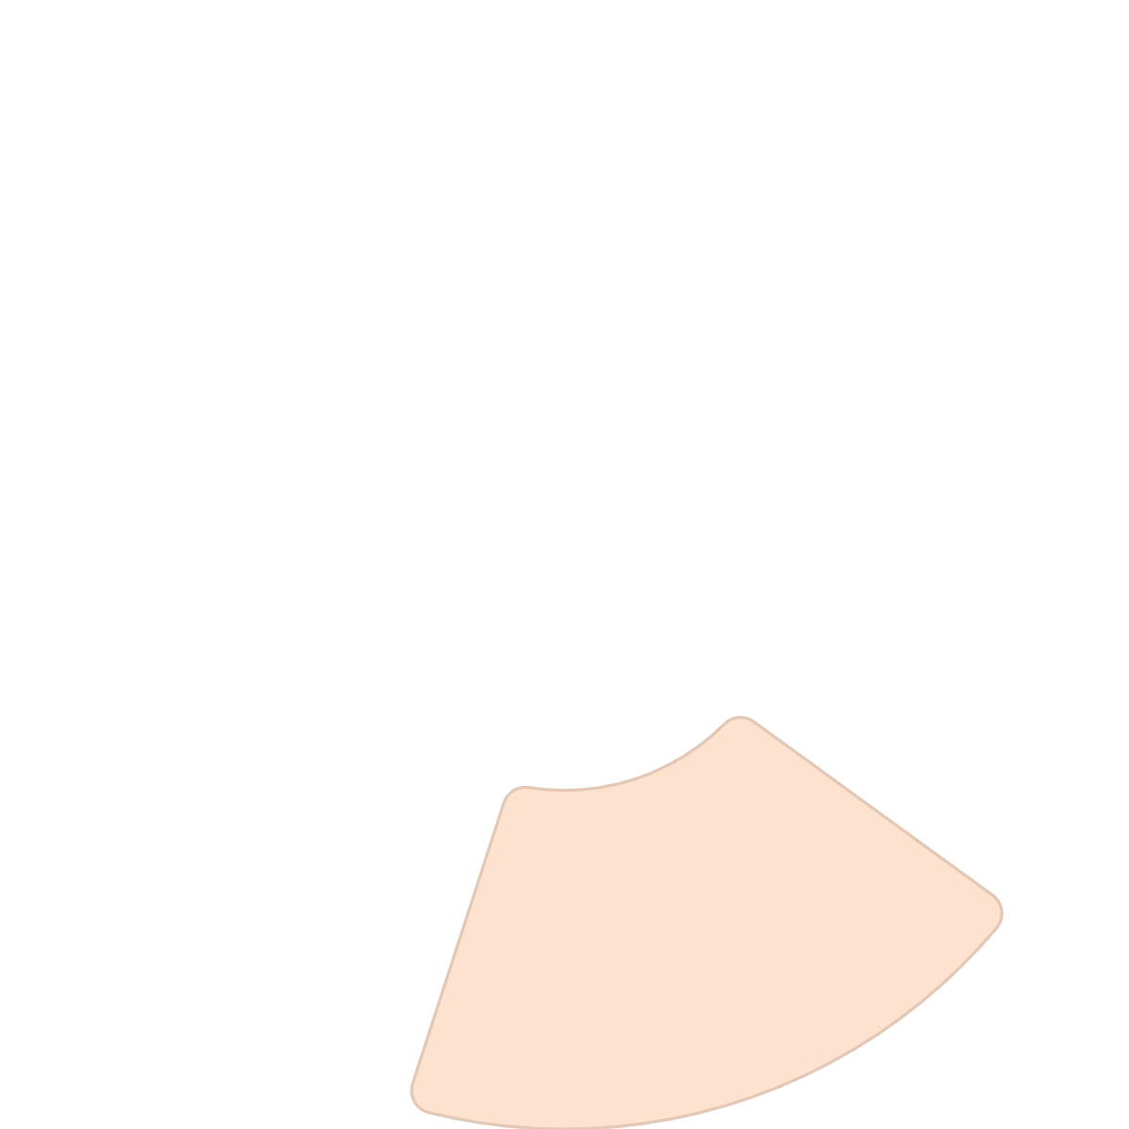
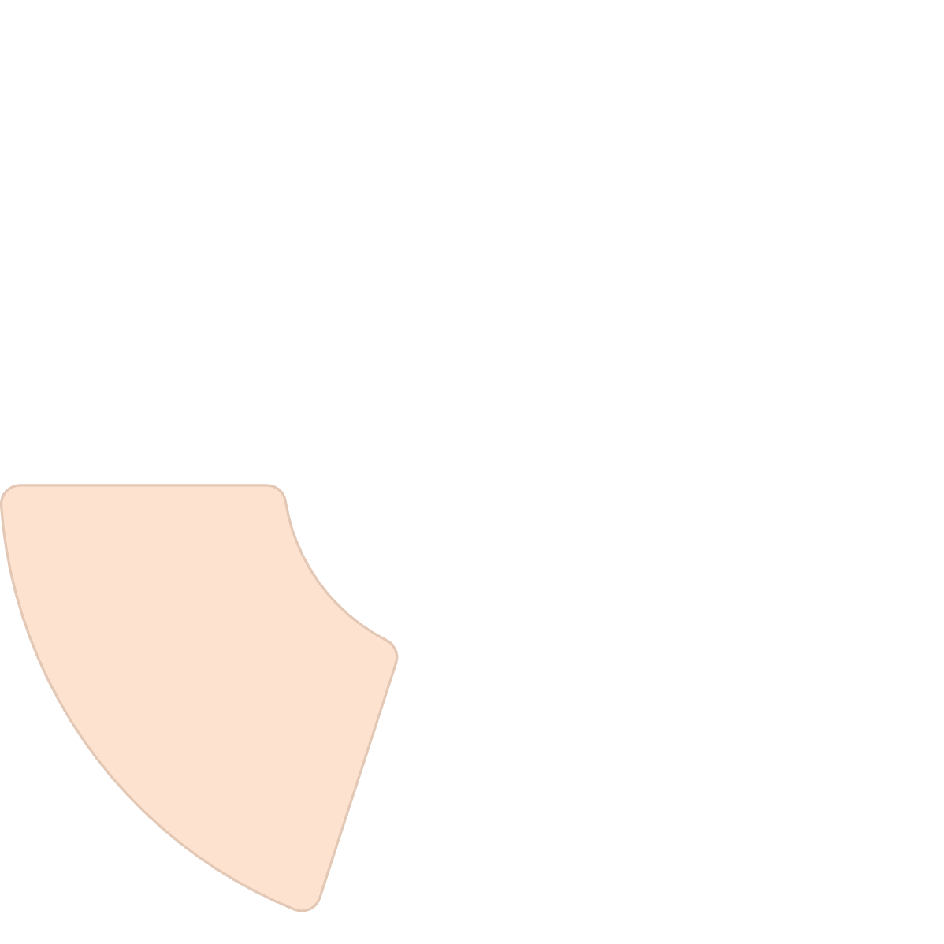

The 4+1 Architectural View Model
The 4+1 model, developed by Philippe Kruchten, provides a comprehensive framework for documenting software architecture through multiple complementary views. Each view addresses specific concerns and serves different stakeholders.
Development View
Logical View
How it's built: Code organization and structure
What it does: Functional components and relationships
Process View
How it runs: Runtime behavior and concurrency
Scenarios
Why it works: Use cases tying all views together
Physical View
Where it runs: Infrastructure and deployment

Slide 13
Logical View: System Functionality
Purpose
E-Commerce Example
Shows the system's functional parts, focusing on what the system does from an end-user perspective. This view captures the key abstractions and their relationships.
User Management
Authentication, profiles, preferences
Primary Audience
Software architects
Product Catalog
Developers
Search, browse, recommendations
Business analysts
Common Diagrams
Shopping Cart
Component diagrams
Class diagrams
Add items, manage quantities
Module diagrams
Order Processing
Checkout, payment, fulfillment
Inventory Management
Stock tracking, warehouse integration

Slide 14
Development, Process & Physical Views
Development View
Process View
Physical View
How it's built: Shows code organization—repositories, packages, libraries, and folder structures. Helps developers understand where code lives and how modules depend on each other.
How it runs: Shows runtime behavior including threads, processes, concurrency, and communication patterns. Critical for understanding performance and scalability.
Where it runs: Shows infrastructure—servers, containers, databases, networks, and cloud resources. Maps software components to physical hardware or cloud services.
Audience: DevOps, system designers, performance engineers
Audience: Developers, build engineers
Audience: DevOps, cloud engineers, infrastructure teams
Example: Monorepo with separate folders for frontend, backend, and shared utilities
Example: Request handled by load balancer, processed by worker threads, queued for background jobs
Example: Kubernetes cluster with pods across three availability zones, RDS database, S3 storage

Slide 15

Scenarios View: Tying It All Together
The Scenarios view (also called Use Case view) is the "+1" in the 4+1 model. It shows how the system fulfills user needs and business requirements, providing concrete examples that validate and illustrate the other views.
User Initiates Action
Processing
Customer clicks "Place Order" button in shopping cart
Create order record, charge payment, update inventory
1
2
3
4
System Validates
Confirmation
Check inventory, validate payment method, calculate shipping
Send email, update order status, notify fulfillment
This scenario touches all views: logical (components involved), development (code modules), process (transaction handling), and physical (database and services). It demonstrates how architectural decisions work together to deliver value.
Key insight: Scenarios help stakeholders understand why architectural decisions matter by showing real-world workflows.

Slide 16
Activity Questions: Identify the Architectural View
Which view describes how different modules like Login, Search, and Payments are organized and connected in the system?
Which view explains how the system is deployed across cloud servers, databases, load balancers, and networks?
Which view shows how code is divided into packages, folders, and repositories for frontend and backend?
Which view illustrates how user actions trigger a sequence of events—for example, placing an order and receiving a confirmation?
Which view focuses on runtime behavior—how processes run in parallel, communicate, and handle high traffic?

Slide 17
Key Takeaways: Building Better Systems
Architecture is Foundation
Multiple Perspectives Matter
Think Before Building
Software architecture provides the essential blueprint that determines whether systems scale, perform, and evolve successfully over time.
Use the 4+1 architectural views to communicate effectively with different stakeholders and ensure all aspects of the system are considered.
Invest time upfront in architectural decisions—they're expensive to change and impact everything that follows.
Great architecture isn't about following rigid rules—it's about making thoughtful decisions that balance current needs with future flexibility. Start your next project by asking: What architectural approach will best serve our users, our team, and our business goals?

Slide 18
Q&A Session

